Slide 1

PROJECT NAME: CAR PRICE PREDICTION
SUBMITTED BY
RAUSHAN KUMAR

Slide 2
INTRODUCTION
Determining whether the listed price of a used car is a challenging task, due to the many factors that drive a used vehicle’s price on the market. The focus of this project is developing machine learning models that can accurately predict the price of a used car based on its features, in order to make informed purchases.
In this project ,various learning methods on a dataset consisting of the sale prices of different makes and models are implemented and evalutaed . We will compare the performance of various machine learning algorithms like Linear Regression, Ridge Regression, Lasso regression, Decision Tree Regressor ,RandomForest Regressor and choose the best out of it. Depending on various parameters we will determine the price of the car. Regression Algorithms are used because they provide us with continuous value as an output and not a categorized value because of which it will be possible to predict the actual price a car rather than the price range of a car. User Interface has also been developed which acquires input from any user and displays the Price of a car according to user’s inputs.

Slide 3
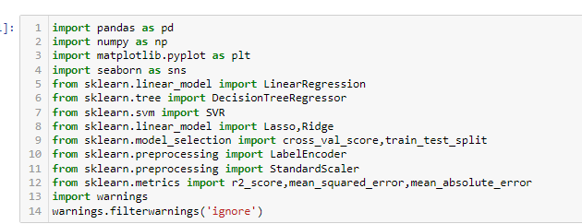
Importing all necessary libraries

Slide 4
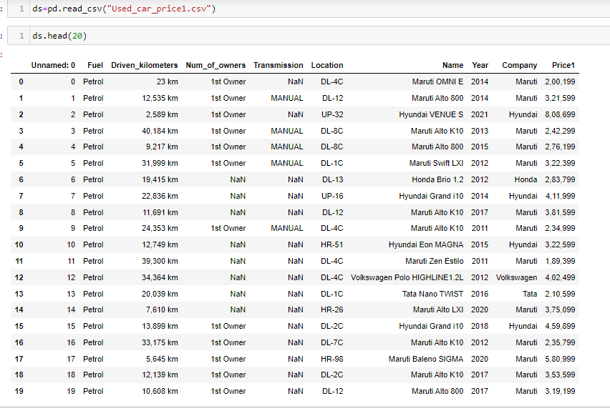
Load The data set

Slide 5

Shape of data set

Slide 6
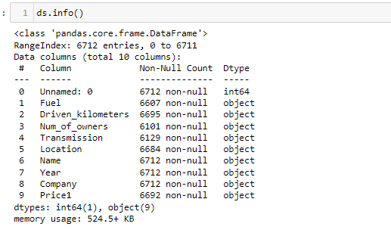
Info about data set

Slide 7
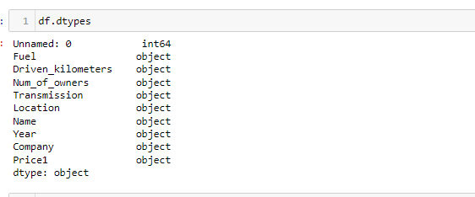
Checking data types

Slide 8
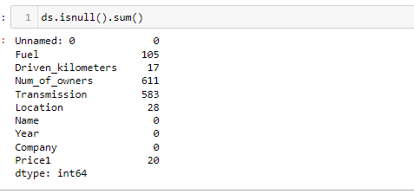
Checking missing values

Slide 9
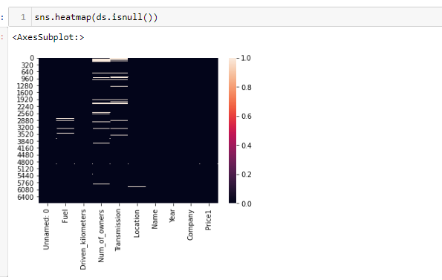
Heatmap

Slide 10
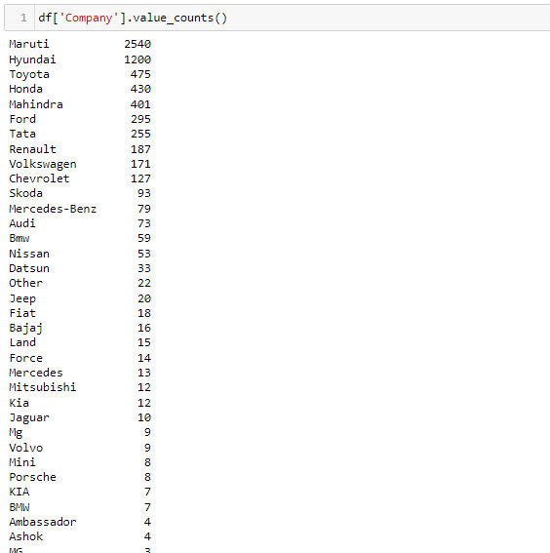
Company column

Slide 11
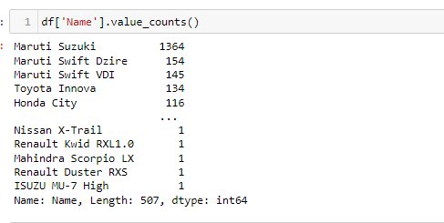
Name column

Slide 12
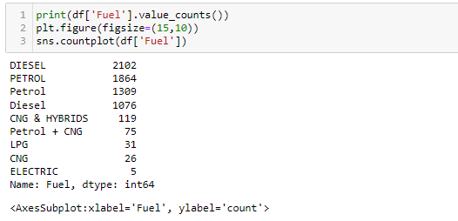
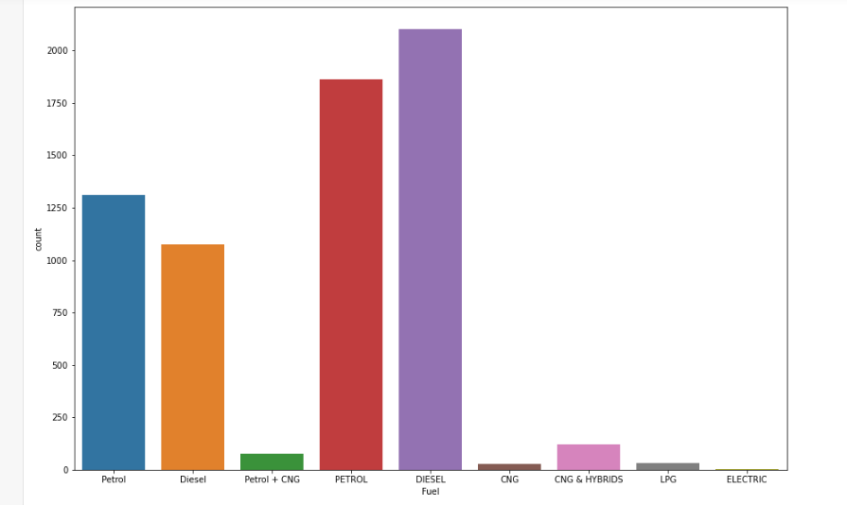
Fuel column

Slide 13
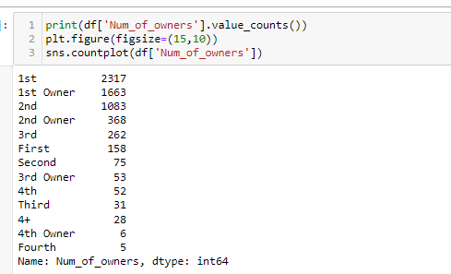
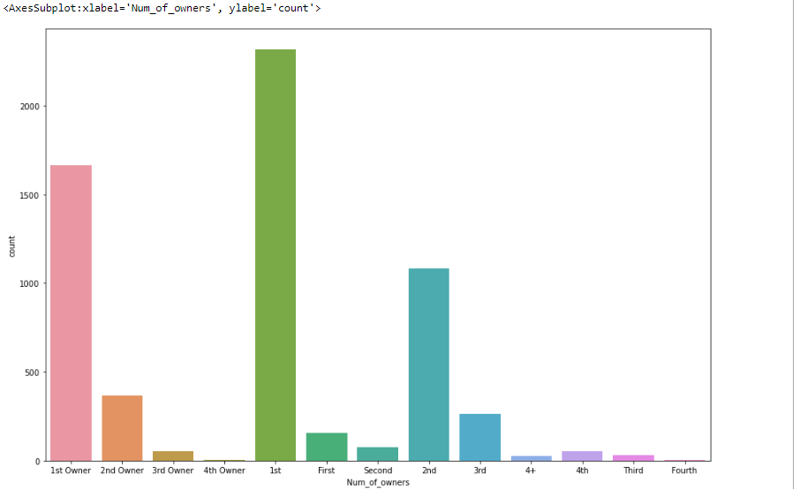
No. Of Owners column

Slide 14
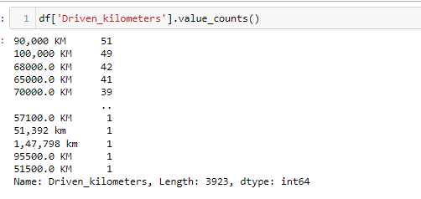
Kilometers Driven column

Slide 15
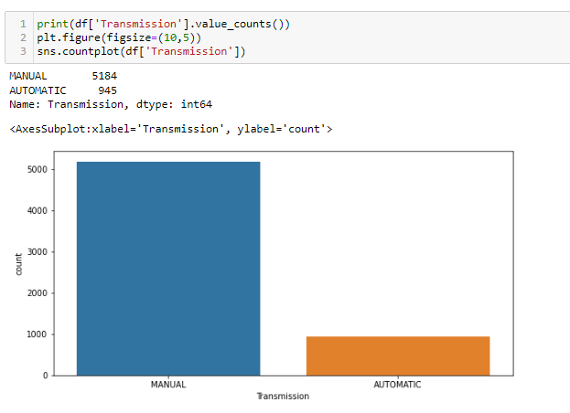
Transmission column

Slide 16
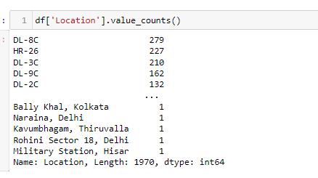
Location column

Slide 17
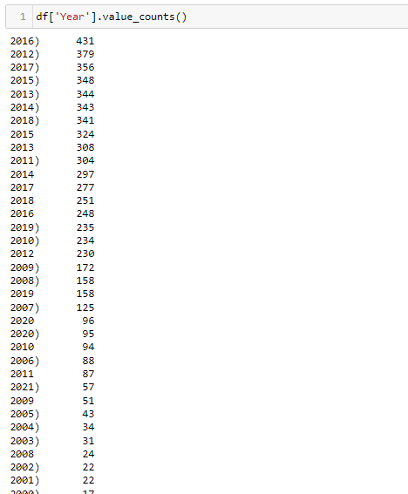
Year column

Slide 18
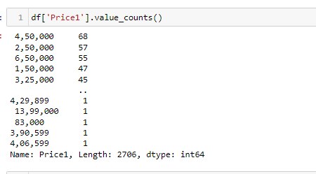
Price column

Slide 19
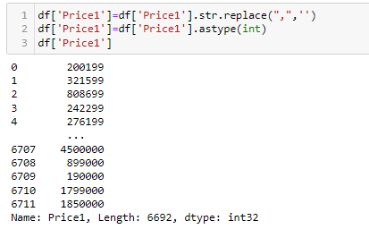
Preprocessing on price column

Slide 20
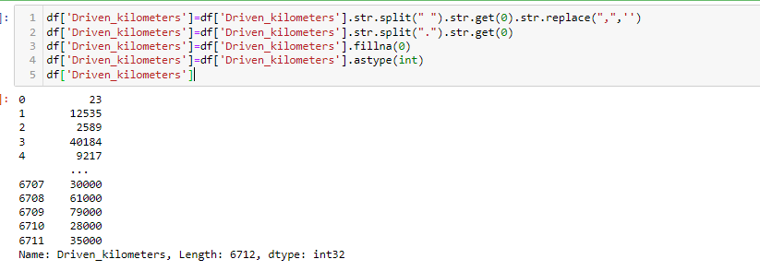
Preprocessing on Driven_kilometers

Slide 21
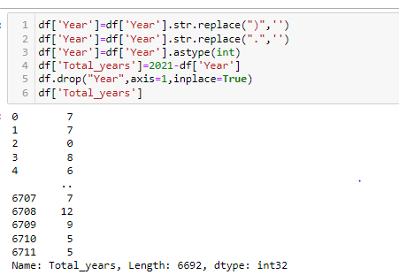
Preprocessing on year column

Slide 22
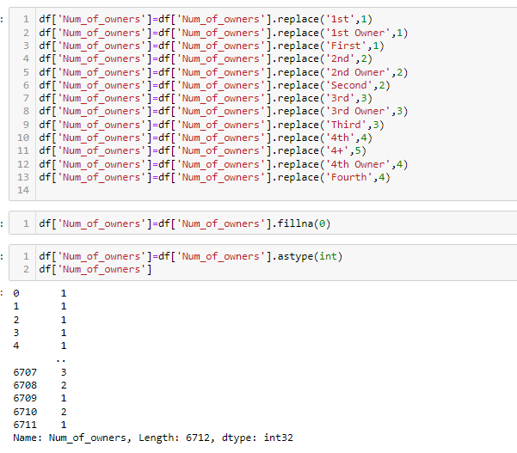
Preprocessing on Num_of_owners

Slide 23
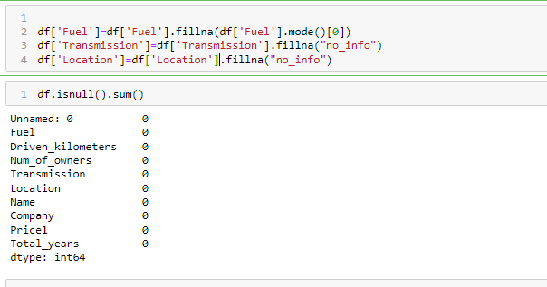
Filling missing values

Slide 24
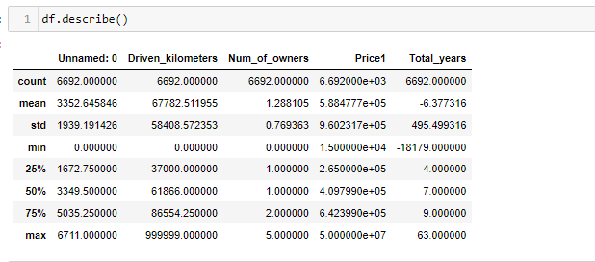
Statistical Summary

Slide 25
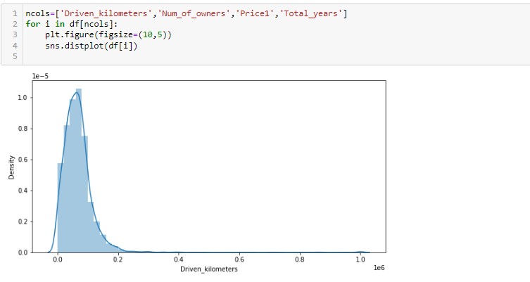
Distplot

Slide 26
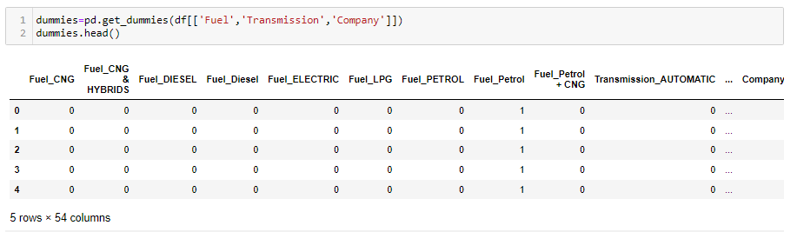
Encoding

Slide 27

Label Encoder

Slide 28
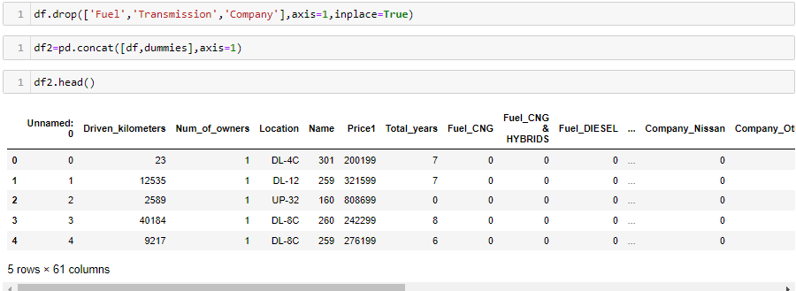
Dropping columns and concat new columns

Slide 29

Dropped unnecessary columns

Slide 30

Separate input columns and target columns

Slide 31
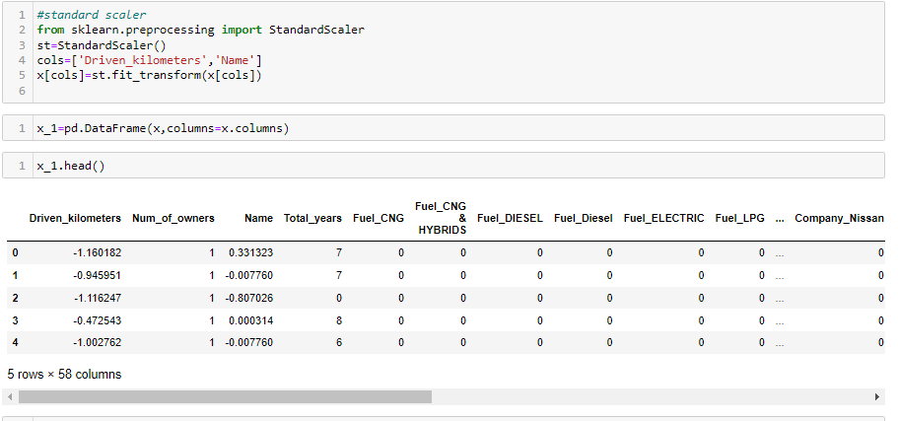
Standard scaler

Slide 32
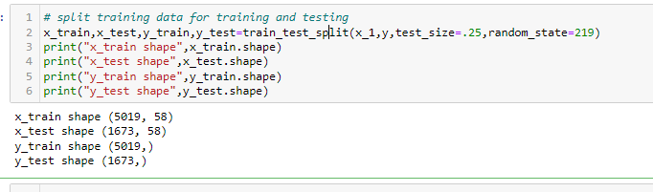
Train_Test_Split

Slide 33
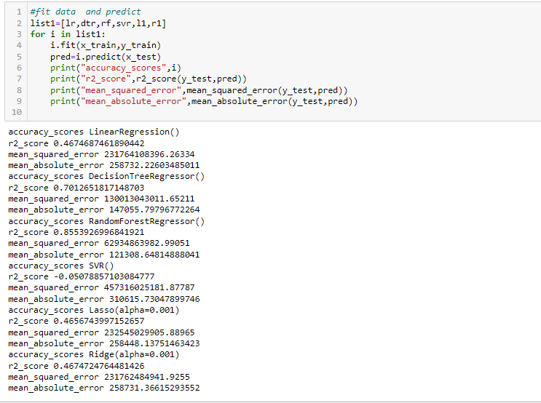
Fit and Predict data

Slide 34
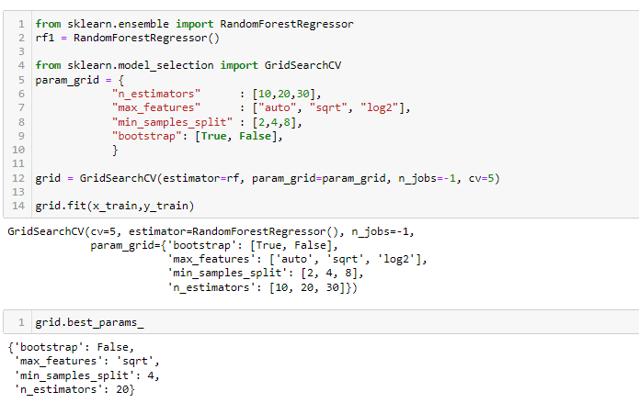
HyperParameterTunning

Slide 35
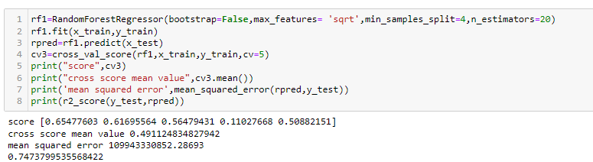
Random Forest Regressor

Slide 36
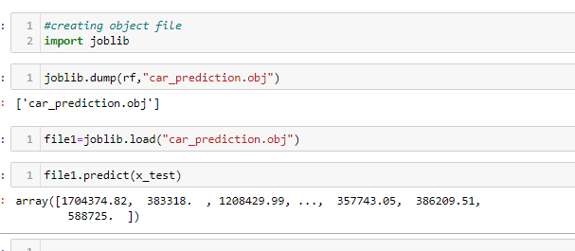
Create object file of best model

Slide 37
Conclusion
The increased prices of new cars and the financial incapability of the customers to buy them, Used Car sales are on a global increase. Therefore, there is an urgent need for a Used Car Price Prediction system which effectively determines the worthiness of the car using a variety of features. The proposed system will help to determine the accurate price of used car price prediction.
In this project different regression algorithms are used, and Random Forest Regressor give high score so selected that one.

Slide 38
Future scope
We may add large historical data of car price which can help to improve accuracy of the machine learning model. We can build an android app as user interface for interacting with user. For better performance, we plan to judiciously design deep learning network structures, use adaptive learning rates and train on clusters of data rather than the whole dataset.

